Slide 1
A Scalable Solver for the Linearized Poisson-Boltzmann Equation on Cartesian Grids with Hierarchical Local Refinement
Tesi di Laurea Magistrale in
Mathematical Engineering - Ingegneria Matematica
Advisor:
Prof. Carlo de Falco
Co-advisors:
Dr. Walter Rocchia, Dr. Sergio Decherchi
Candidate:
Martina Politi, 953448
Academic year:
2020-2021

Slide 2

Introduction
Development of modern calculus tools for applications in Molecular Biology
Implemention of easy_pbe solver as an alternative to Delphi

Slide 3
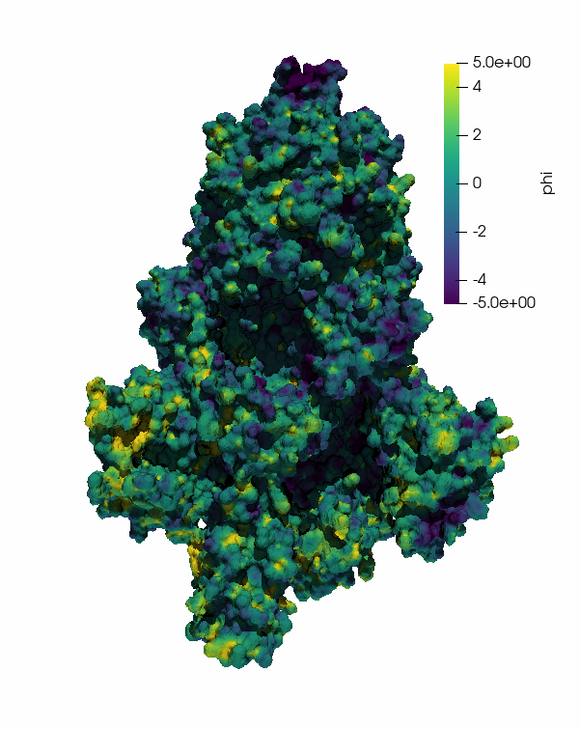
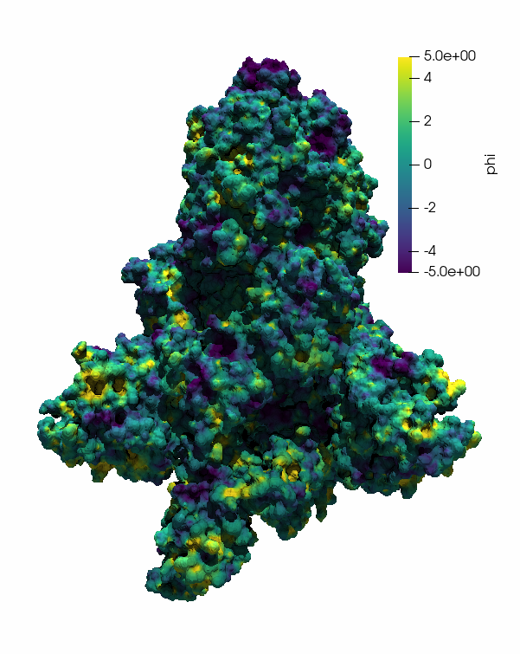
Introduction
Computation of the Electrostatic Potential
Drug discovery and drug repurposing
Application to COVID-19 and new diseases
SARS-CoV-2, spike protein, ectodomain structure open state.
SARS-CoV-2, spike protein, Omicron variant of concern.

Slide 4
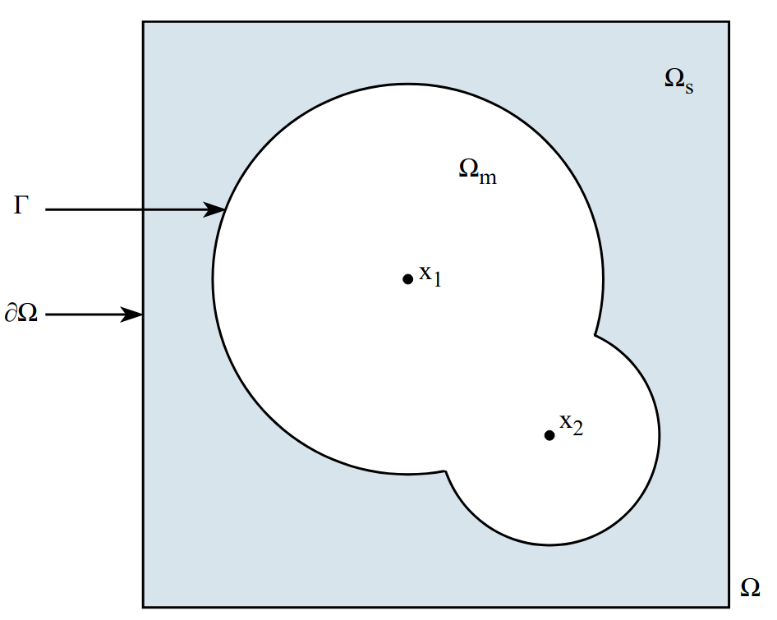
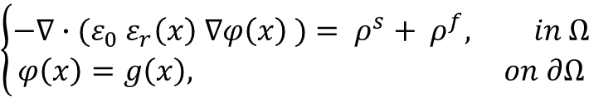
The Poisson-Boltzmann Equation
Nondimensional form of the PBE:
$$\left\{\begin{aligned}−∇∙{(ε}_{0}{ ε}_{r}\left(x\right) ∇φ\left(x\right) )= ρ^{s}+ ρ^{f}, in Ω \\ φ\left(x\right)=g\left(x\right), on ∂Ω\end{aligned}\right.$$

Slide 5
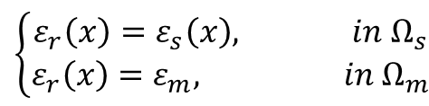
The Poisson-Boltzmann Equation
Nondimensional form of the PBE:
$$\left\{\begin{aligned}−∇∙{(ε}_{0}{ ε}_{r}\left(x\right) ∇φ\left(x\right) )= ρ^{s}+ ρ^{f}, in Ω \\ φ\left(x\right)=g\left(x\right), on ∂Ω\end{aligned}\right.$$
Relative dielectric permittivity:
$$\left\{\begin{aligned}ε_{r}\left(x\right)=ε_{s}\left(x\right), in Ω_{s} \\ ε_{r}\left(x\right)=ε_{m}, in Ω_{m}\end{aligned}\right.$$

Slide 6
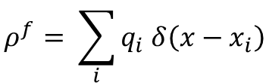
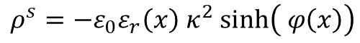
The Poisson-Boltzmann Equation
Nondimensional form of the PBE:
$$\left\{\begin{aligned}−∇∙{(ε}_{0}{ ε}_{r}\left(x\right) ∇φ\left(x\right) )= ρ^{s}+ ρ^{f}, in Ω \\ φ\left(x\right)=g\left(x\right), on ∂Ω\end{aligned}\right.$$
Relative dielectric permittivity:
$$\left\{\begin{aligned}ε_{r}\left(x\right)=ε_{s}\left(x\right), in Ω_{s} \\ ε_{r}\left(x\right)=ε_{m}, in Ω_{m}\end{aligned}\right.$$
Fixed charge density:
$$ρ^{f}= \sum_{i}{q_{i} δ\left(x−x_{i}\right)}$$
Density of solution ions:
$$ρ^{s}=−ε_{0}ε_{r}\left(x\right){ κ}^{2} sinh⁡\left( φ\left(x\right)\right)$$

Slide 7
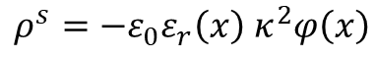
The Poisson-Boltzmann Equation
Nondimensional form of the PBE:
$$\left\{\begin{aligned}−∇∙{(ε}_{0}{ ε}_{r}\left(x\right) ∇φ\left(x\right) )= ρ^{s}+ ρ^{f}, in Ω \\ φ\left(x\right)=g\left(x\right), on ∂Ω\end{aligned}\right.$$
Relative dielectric permittivity:
$$\left\{\begin{aligned}ε_{r}\left(x\right)=ε_{s}\left(x\right), in Ω_{s} \\ ε_{r}\left(x\right)=ε_{m}, in Ω_{m}\end{aligned}\right.$$
Fixed charge density:
$$ρ^{f}= \sum_{i}{q_{i} δ\left(x−x_{i}\right)}$$
Density of solution ions:
$$ρ^{s}=−ε_{0}ε_{r}\left(x\right){ κ}^{2} sinh⁡\left( φ\left(x\right)\right)$$
Linearized PBE
$$ρ^{s}=−ε_{0}ε_{r}\left(x\right){ κ}^{2}φ\left(x\right)$$

Slide 8
Ingredients for the easy_pbe implementation
Finite Element discretization on Oct-tree grids
Approximation of point sources by finite charge density
Geometric representation of the molecular surface
Grid partitioning for parallelization

Slide 9
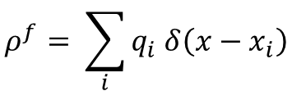
Treatment of Point Sources
Fixed charge density contains point sources:
$$ρ^{f}= \sum_{i}{q_{i} δ\left(x−x_{i}\right)}$$
Singularities in the analytical solution of the PBE

Slide 10
Treatment of Point Sources
Fixed charge density contains point sources:
$$ρ^{f}= \sum_{i}{q_{i} δ\left(x−x_{i}\right)}$$
Singularities in the analytical solution of the PBE
easy_pbe adopts continuous first-order Lagrangian Finite Elements

Slide 11
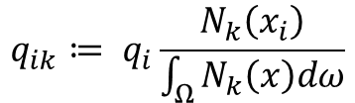
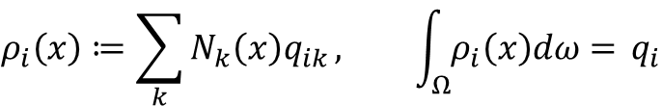
Treatment of Point Sources
Fixed charge density contains point sources:
Smoothed representation of the atomic charges
$$ρ^{f}= \sum_{i}{q_{i} δ\left(x−x_{i}\right)}$$
$$ρ_{i}\left(x\right)≔\sum_{k}{N_{k}\left(x\right)q_{ik}}, \int_{Ω}^{ }{ρ_{i}\left(x\right)dω= }q_{i}$$
Singularities in the analytical solution of the PBE
$$q_{ik}≔ q_{i}\frac{N_{k}\left(x_{i}\right)}{\int_{Ω}^{ }{N_{k}\left(x\right)dω}}$$
easy_pbe adopts continuous first-order Lagrangian Finite Elements
Minimizing the dependence on the adaptive grid

Slide 12
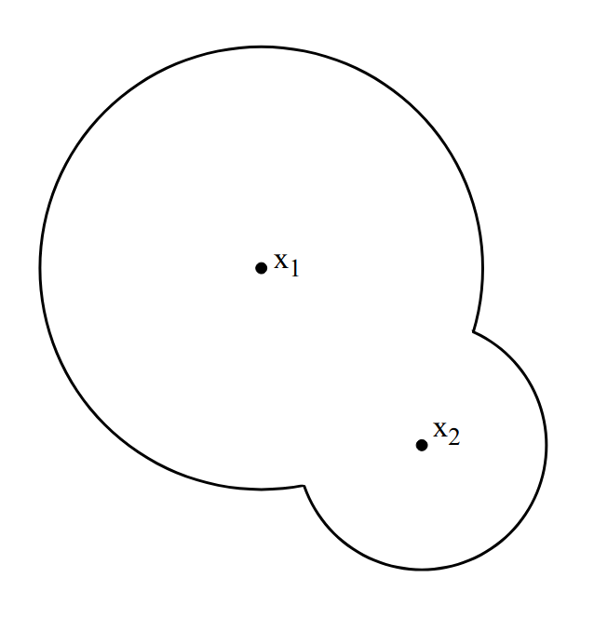
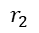
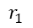
Geometric Representation of the Molecular Surface
Van der Waals:
Simple definition
Not accurate
Numerical problems
$$r_{1}$$
$$r_{2}$$

Slide 13
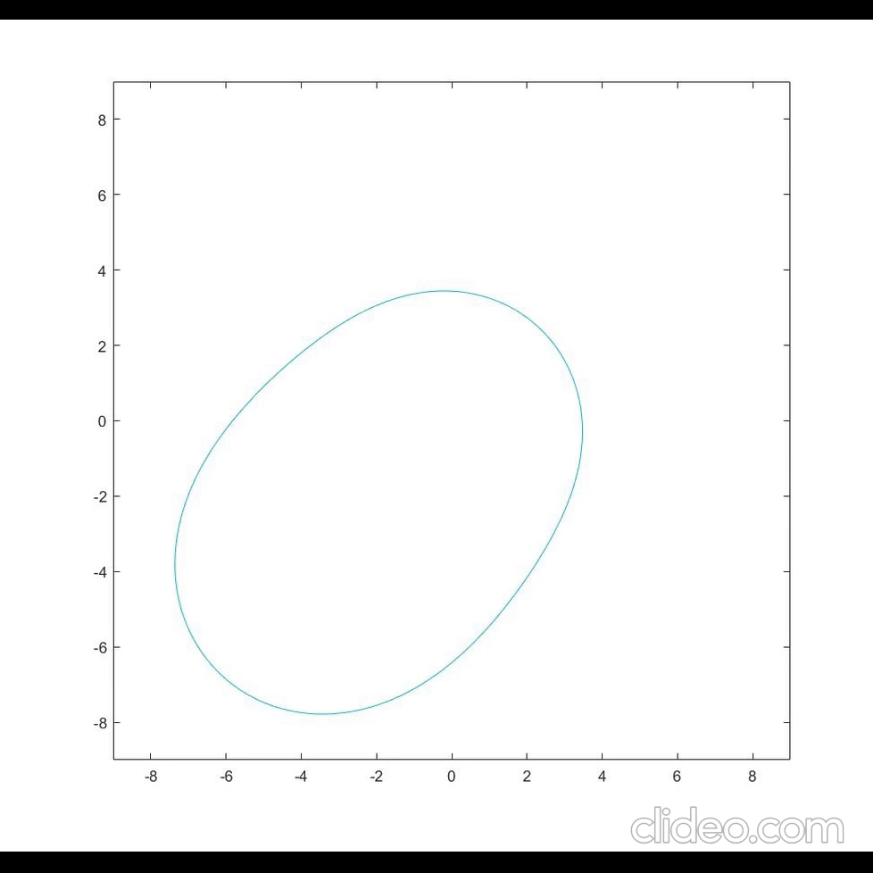
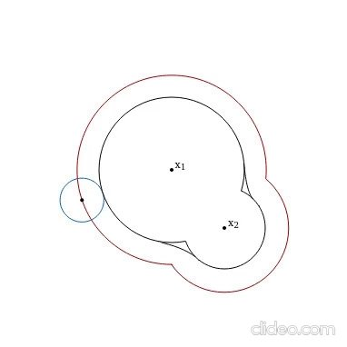
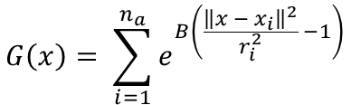
Geometric Representation of the Molecular Surface
Van der Waals:
Simple definition
Not accurate
Numerical problems
Level-set:
Blobby surface
$$S\left(x\right)≔ \left\{x∈ℝ^{3 }: G\left(x\right)=1\right\}$$
$$G\left(x\right)= \sum_{i=1}^{n_{a}}{e^{B\left(\frac{{\left\|x − x_{i}\right\|}^{2}}{r_{i}^{2}} −1\right)}}$$
Blobby surface with B ranging from -0.5 to -3.5.
$$r_{1}$$
Alpha-shapes:
Skin surface
SES surface
$$r_{2}$$

Slide 14
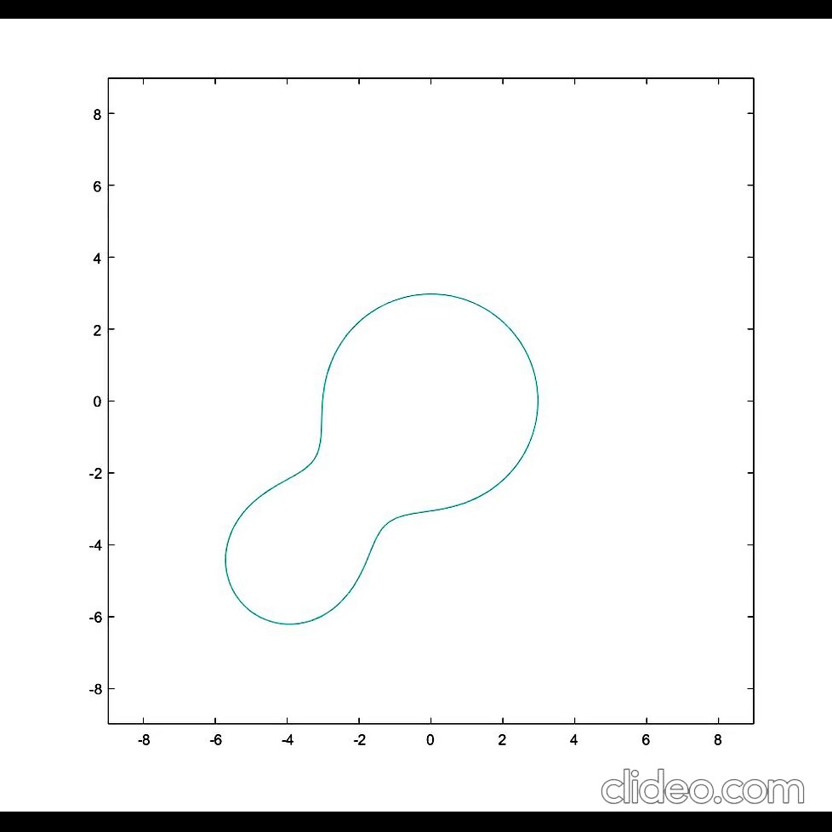
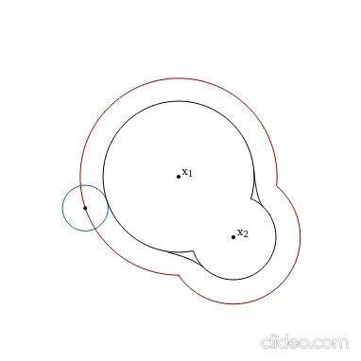
Geometric Representation of the Molecular Surface
Van der Waals:
Simple definition
Not accurate
Numerical problems
Level-set:
Blobby surface
$$S\left(x\right)≔ \left\{x∈ℝ^{3 }: G\left(x\right)=1\right\}$$
$$G\left(x\right)= \sum_{i=1}^{n_{a}}{e^{B\left(\frac{{\left\|x − x_{i}\right\|}^{2}}{r_{i}^{2}} −1\right)}}$$
Blobby surface with B ranging from -0.5 to -3.5.
$$r_{1}$$
Alpha-shapes:
Skin surface
SES surface
$$r_{2}$$

Slide 15
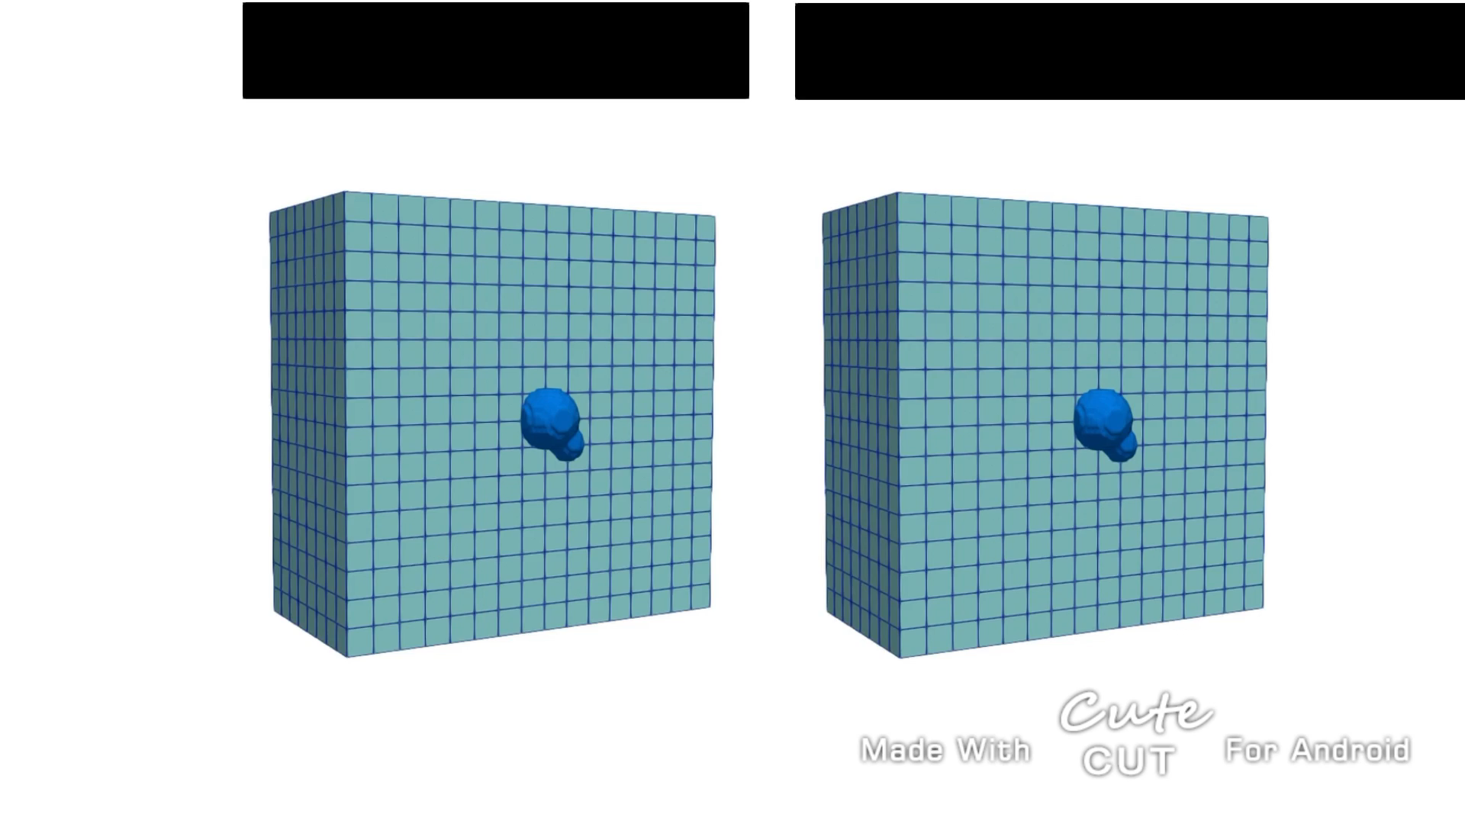
Oct-tree Grids
Tensor product cartesian grids
Oct-tree grids
Smaller linear system dimension
Easier grid management
Oct-tree grid with hierarchical refinement
Min/max level = 2 - 7
Number of cells = 6392
Uniformly refined mesh
Uniform level = 7
Number of cells = 2097152
Adaptive, simplicial, conforming meshes

Slide 16
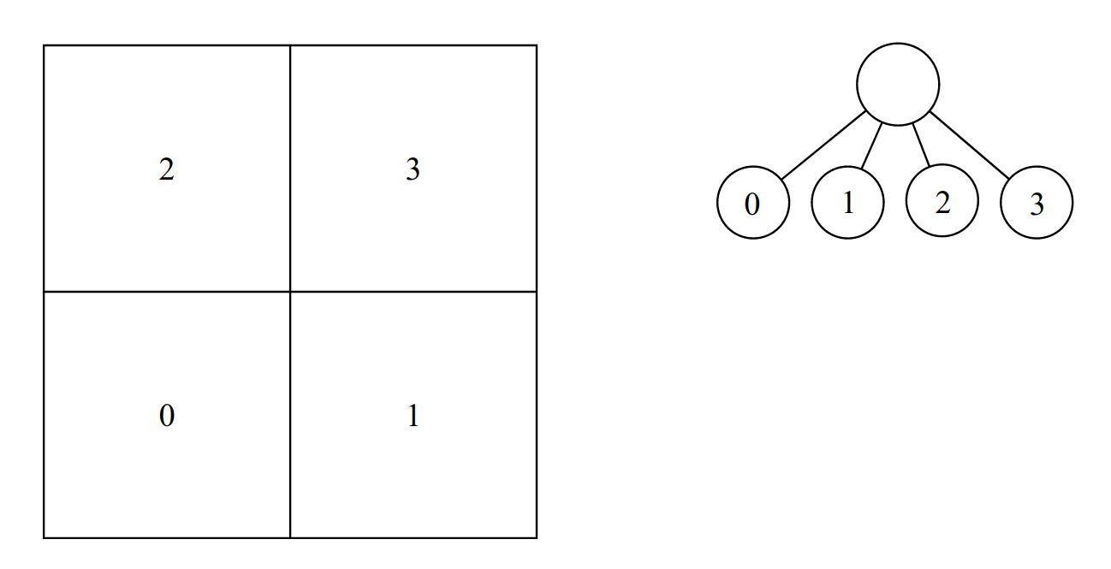
Oct-tree Grids

Slide 17
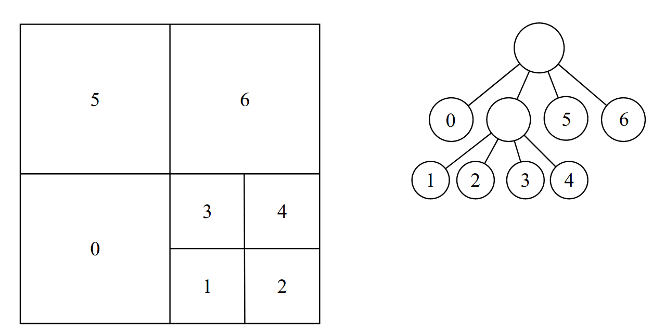
Oct-tree Grids

Slide 18
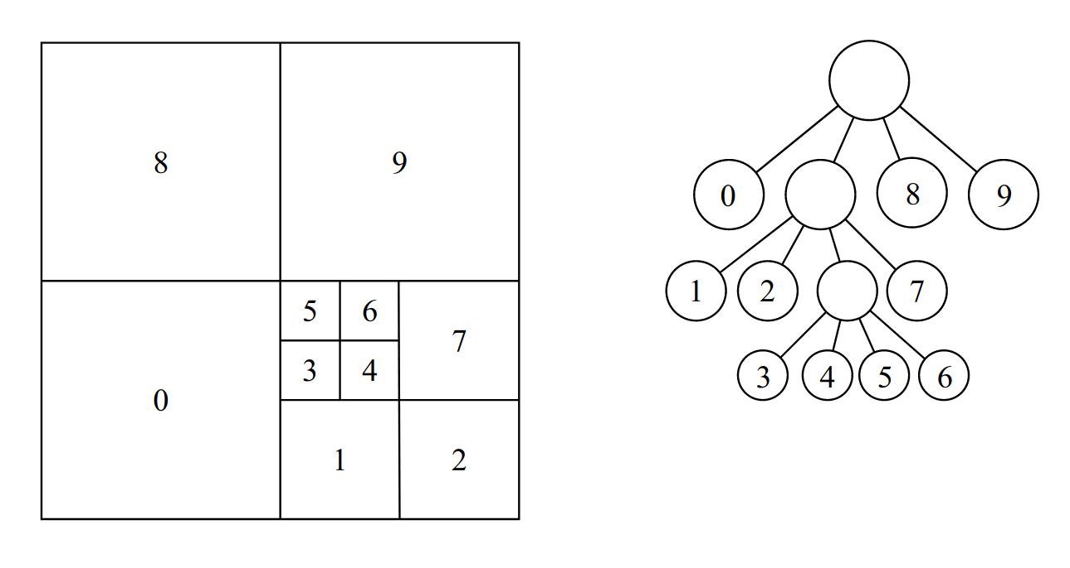
Oct-tree Grids

Slide 19
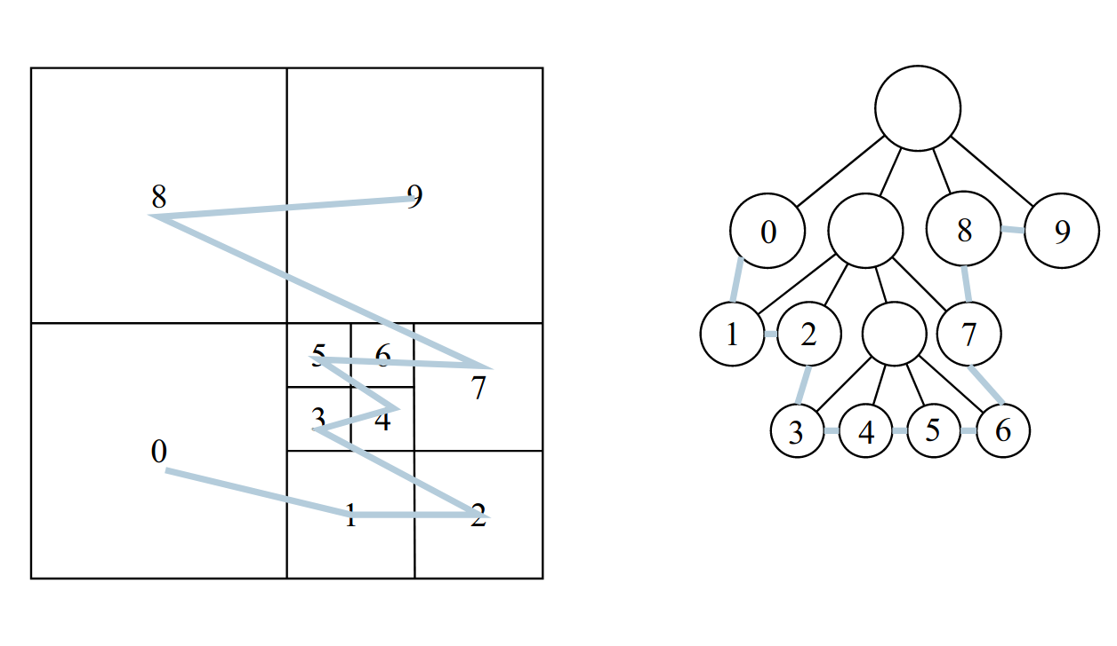
Oct-tree Grids

Slide 20
easy_pbe
Development of a c++ code:
Scalable
Efficient in solving PBE
Able to handle the MS geometry
Client
NanoShaper
Geometry construction
Response
Request
Server
Mesh
bim++
Linear system solution:
Direct methods: MUMPS
Iterartive methods: LIS
FE discretization

Slide 21
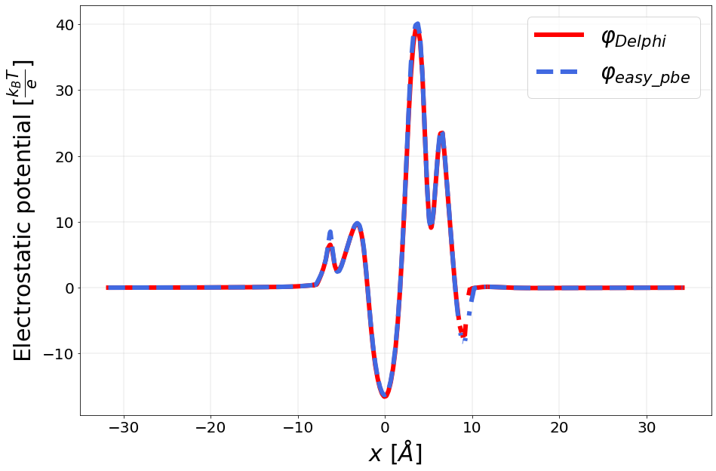
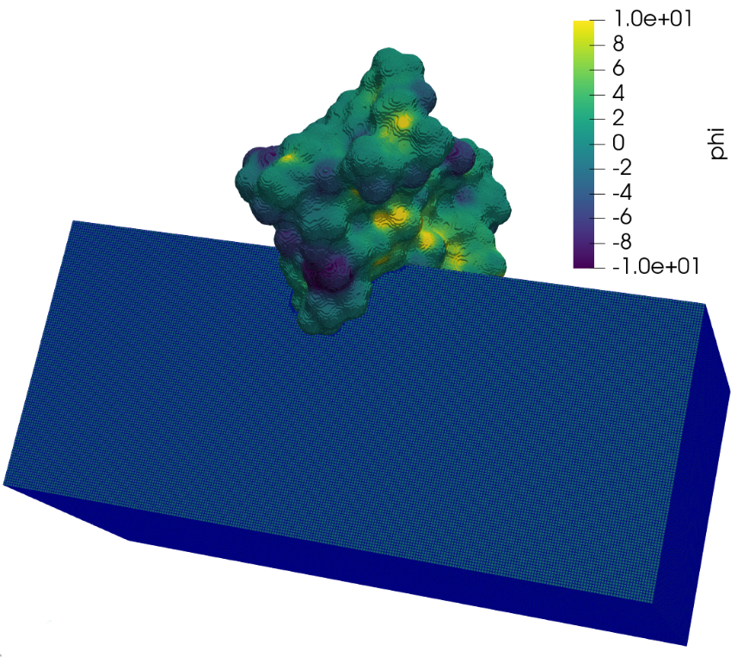
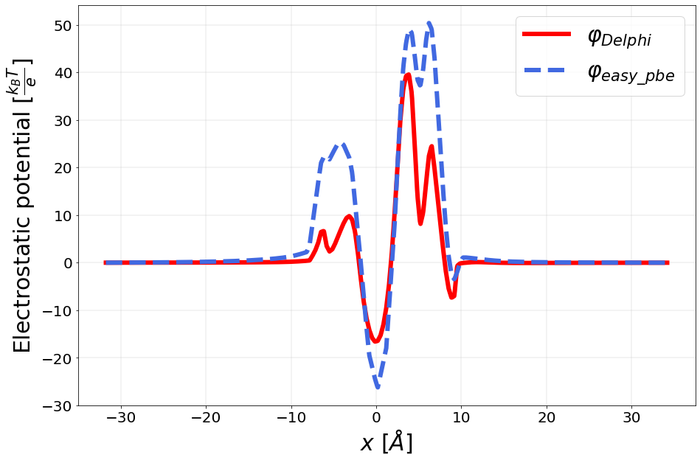
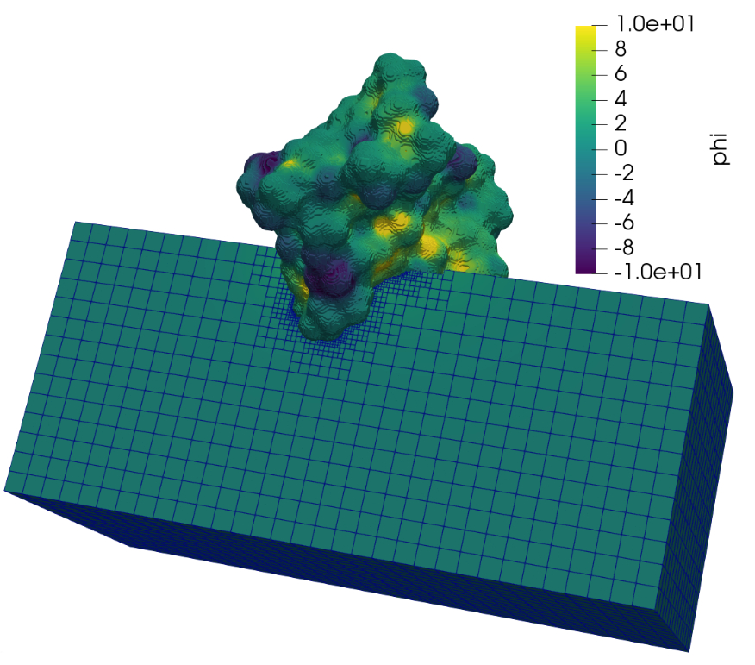
Numerical Results on Real Molecules Validation tests: Crambin molecule
Refinement:
Minlevel = 8
Maxlevel = 9
Refinement:
Minlevel = 5
Maxlevel = 9

Slide 22
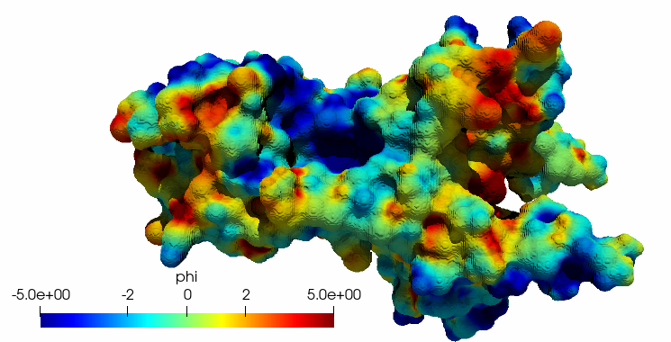
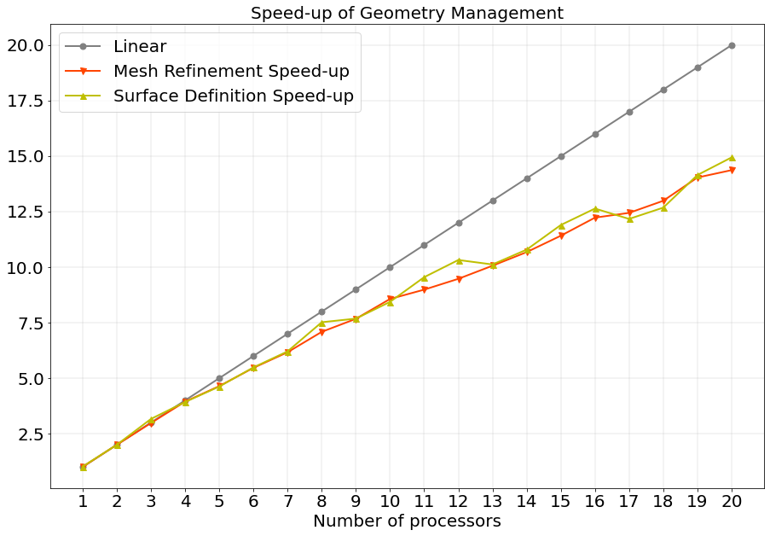
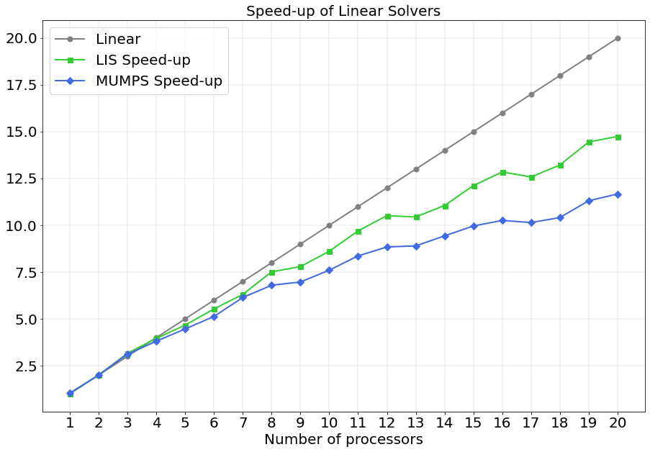
Numerical Results on Real Molecules Parallel scaling test
Nerve growth factor protein, involved in many cell physiological processes.

Slide 23
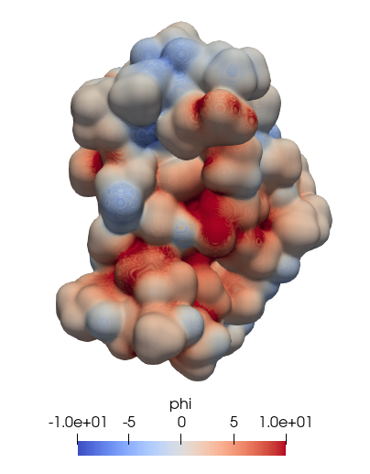
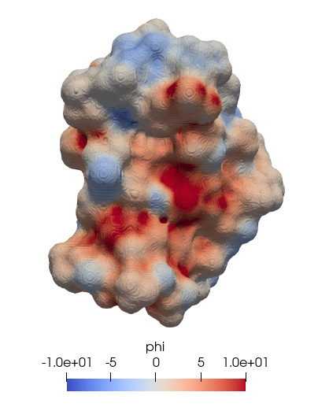
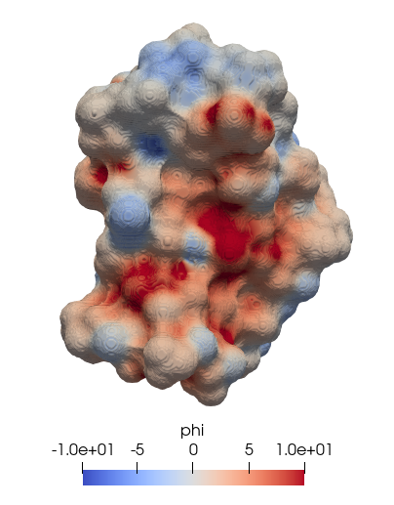
Conclusions
Crambin molecule:
Blobby surface with B = -2.5
Skin surface with s = 0.45
SES with probe radius = 1.4
easy_pbe is a c++ scalable solver
Oct-tree grids
Different molecular surface definitions
Validation with test cases and real molecules
a)
b)
c)

Slide 24
THANK YOU FOR THE ATTENTION!

Slide 25
Bibliografy
https://github.com/carlodefalco/easy_pbe.git.
http://p4est.github.io.
http://optimad.github.io/bitpit/modules/index.html#PABLO.
https://www.ssisc.org/lis/lis-ug-en.pdf.
N. Baker, M. Holst, and F. Wang. Adaptive multilevel finite element solution of the poisson-boltzmann equation ii. refinement at solvent-accessible surfaces in biomolecular systems. J. Comput. Chem., 21:1343– 1352.
M. Born. Volumen und hydratationswärme der ionen. Z. Phys., 1(45), 1920.
A. H. Boschitsch and M. O. Fenley. A fast and robust poisson–boltzmann solver based on adaptive cartesian grids. Journal of Chemical Theory and Computation, 7(5):524–1540, 05 2011.
S. Decherchi, C. E. Catalano J. Colmenare and, M. Spagnuolo, E. Alexov, and W. Rocchia. Between algorithm and model: different molecular surface definitions for the poisson-boltzmann based electrostatic characterization of biomolecules in solution. Commun. Comput. Phys., 13:61–89, January 2013. 26.
M. Holst, N. Baker, and F. Wang. Adaptive multilevel finite element solution of the poisson–boltzmann equation i. algorithms and examples. J. Comput. Chem., 21:1319–1342.
B. Honig and A. Nicholls. Classical electrostatics in biology and chemistry. SCIENCE, 268, MAY 1995.
A. Kucherova, S. Strango, S. Sukenik, and M. Theillard. Computational modeling of protein conformational changes - application to the opening sars-cov-2 spike. Journal of Computational Physics, 444:110591, 2021.
A. Lee, W. Geng, and S. Zhao. Regularization methods for the poisson-boltzmann equation: Comparison and accuracy recovery. Journal of Computational Physics, 426:109958, 2021.
C. Li, Z. Jia, A. Chakravorty, S. Pahari, Y. Peng, S. Basu, M. Koirala, S.K. Panday, M. Petukh, L. Li, and E. Alexov. Delphi suite: New developments and review of functionalities. J Comput Chem., 40(28):2502– 2508, Oct 2019.
L. Li, C. Li, S. Sarkar, J. Zhang, S. Witham, Z. Zhang, L. Wang, N. Smith, M. Petukh, and E. Alexov. Delphi: a comprehensive suite for delphi software and associated resources. BMC Biophys, 4(1), May 2012.
J. A. Wilson, A. Bender, T. Kaya, and P. A. Clemons. Alpha shapes applied to molecular shape characterization exhibit novel properties compared to established shape descriptors. J. Chem. Inf. Model., 49(10):2231–2241, 2009.

Slide 26
Introduction
Understanding of physical/chemical properties of molecules in acqueous solutions
Describing the strength and the nature of the ELECTROSTATIC INTERACTIONS
FOR
1920
1995
2021
Max Born, Volumen und hydratationswärme der ionen [10].
Barry Honig and Anthony Nicholls,
Classical electrostatics in biology and chemistry [17].
Application to the opening
Sars-Cov-2 spike protein [19].

Slide 27
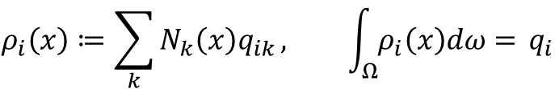
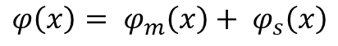
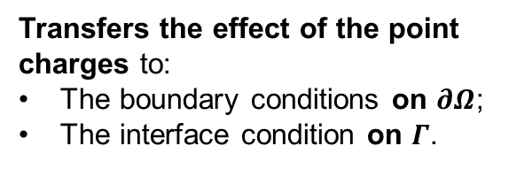
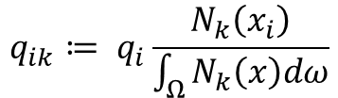
Treatment of Point Sources
Presence of Point Sources
induces SINGULARITIES
Smoothed representation of the atomic charges
Regularized reformulation
$$ρ_{i}\left(x\right)≔\sum_{k}{N_{k}\left(x\right)q_{ik}}, \int_{Ω}^{ }{ρ_{i}\left(x\right)dω= }q_{i}$$
$$φ\left(x\right)= φ_{m}\left(x\right)+ φ_{s}\left(x\right)$$
Transfers the effect of the point charges to:
The boundary conditions on $∂Ω$;
The interface condition on $Γ$.
$$q_{ik}≔ q_{i}\frac{N_{k}\left(x_{i}\right)}{\int_{Ω}^{ }{N_{k}\left(x\right)dω}}$$

Slide 28
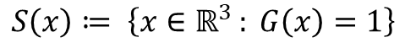
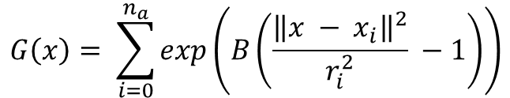
Geometric Representation of the Molecular Surface: Blobby Surface
$$S\left(x\right)≔ \left\{x∈ℝ^{3 }: G\left(x\right)=1\right\}$$
$$G\left(x\right)= \sum_{i=0}^{n_{a}}{exp\left(B\left(\frac{{\left\|x − x_{i}\right\|}^{2}}{r_{i}^{2}} −1\right)\right)}$$
PROS | CONS
Simple and intuitive definition | Cannot be partitioned in analytical patches
Easy to implement | No easy projection methods
Smooth surface | Difficult B tuning
Crambin molecule, Blobby surface with B = -2.5.

Slide 29
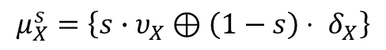
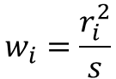
Geometric Representation of the Molecular Surface: Skin Surface
$$S= \left\{p_{i}=\left(x_{i},w_{i}\right) , x_{i}∈ℝ^{3}, i=1, …, n_{a}\right\}$$
$$w_{i}=\frac{r_{i}^{2}}{s}$$
Mixed cells:
$$μ_{X}^{s}=\left\{s∙υ_{X}⊕\left(1−s\right)⋅ δ_{X}\right\}$$
PROS | CONS
Use of fast algorithms, e.g. Voronoi diagram and Delaunay tetrahedrization | Higher computational costs w.r.t. SES
Limited pathological configurations | Unphysical high dielectric cavities
Crambin molecule, Skin surface with s = 0.45.

Slide 30
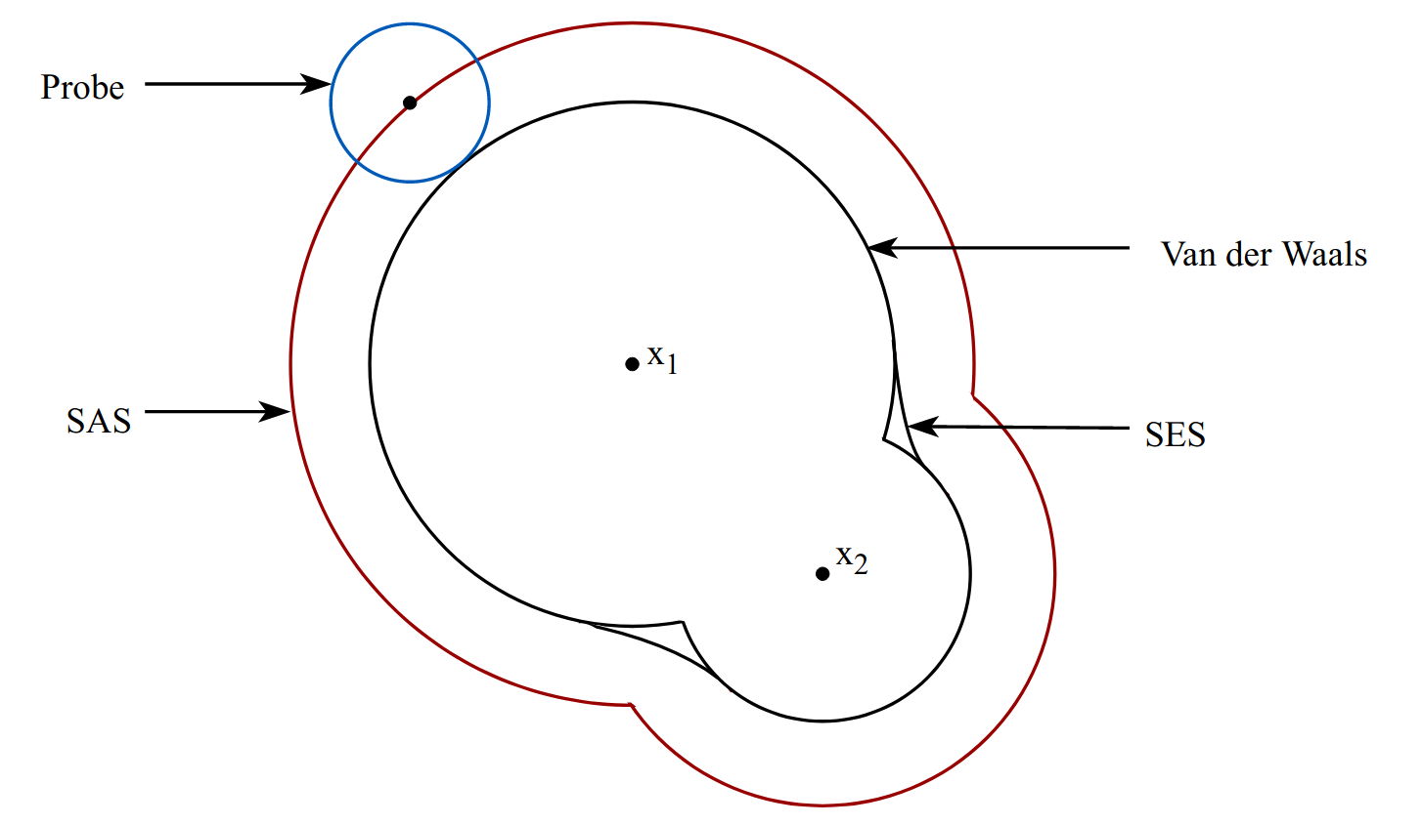
Geometric Representation of the Molecular Surface: SES Surface
Crambin molecule, SES surface with probe = 1.4.

Slide 31
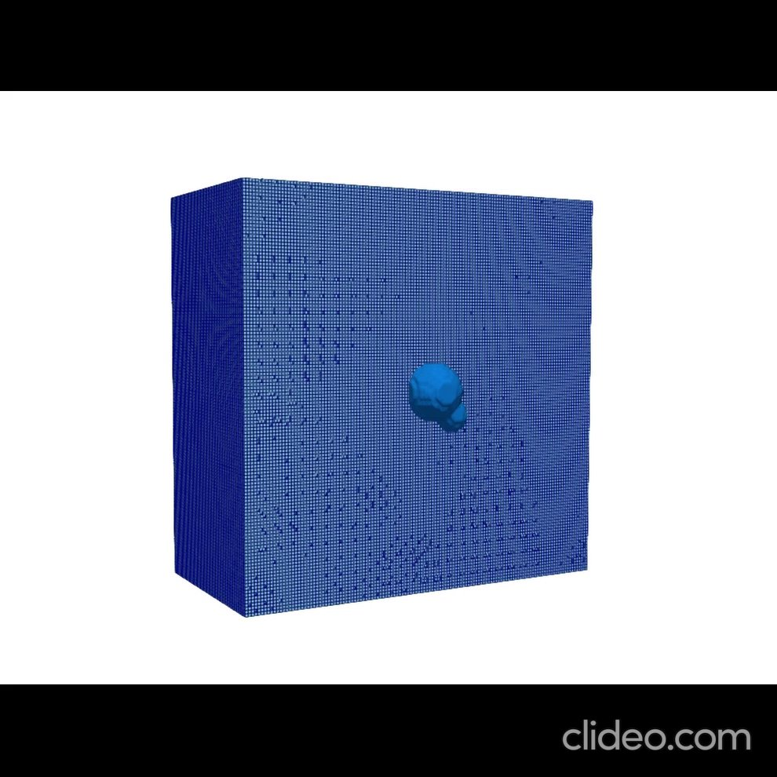
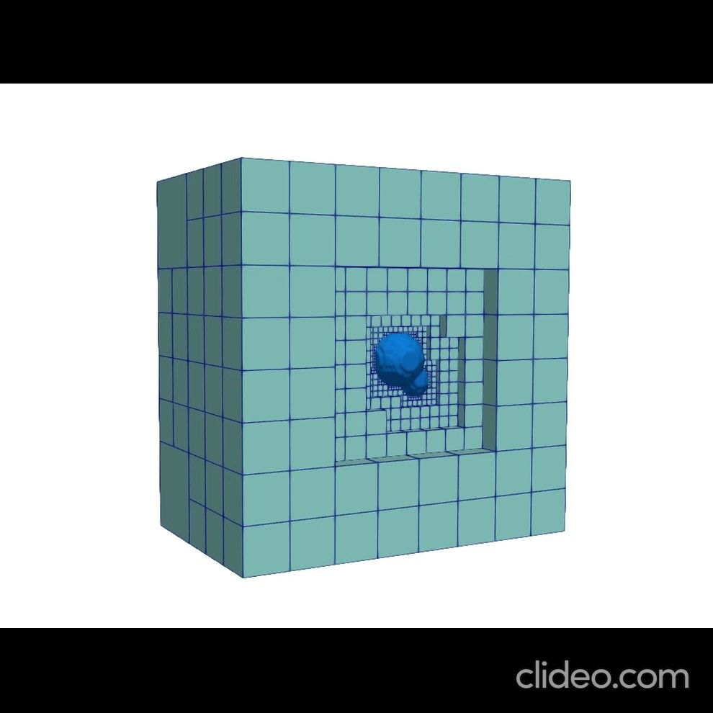
Oct-tree Grids
Tensor product cartesian grids
Oct-tree grids
Smaller linear system dimension
Easier grid management
Oct-tree grid with hierarchical refinement
Min/max level = 2 - 7
Number of cells = 6392
Uniformly refined mesh
Uniform level = 7
Number of cells = 2097152
Adaptive, simplicial, conforming meshes

Slide 32
easy_pbe Description and Implementation
Development of a c++ code using:
bim++ library
NanoShaper library
Algorithm steps:
Data Input
Surface Creation
Mesh Creation and Refinement
Ray Caching
Matrix and Vectors Assembling
Linear System Solution

Slide 33
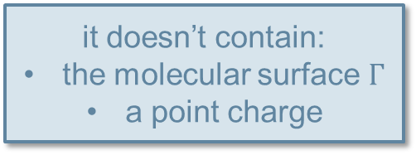
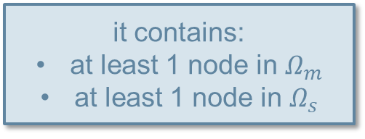
easy_pbe Description and Implementation
2. Surface Creation
Mesh Creation and Refinement Cell marked for refinement if Cell marked for coarsening if
it contains:
at least 1 node in $Ω_{m}$
at least 1 node in $Ω_{s}$
it contains a point charge
it doesn’t contain:
the molecular surface $Γ$
a point charge

Slide 34
easy_pbe Description and Implementation
Ray Caching NanoShaper: executed either in serial or using multiple threads. easy_pbe: parallelization rely on MPI multi-core.
ray_cache_t class functions involved in the caching operation:
crossings_t & operator() (double x0, double x1)
void fill_cache ()
Serialization process
MPI functions

Slide 35
easy_pbe Description and Implementation
Matrix and Vectors Assembling
Linear System Solution
Use of bim++ functions:
bim3a_advection_diffusion
bim3a_reaction
bim3a_rhs
Distributed vectors and matrices
MUMPS
LIS

Slide 36
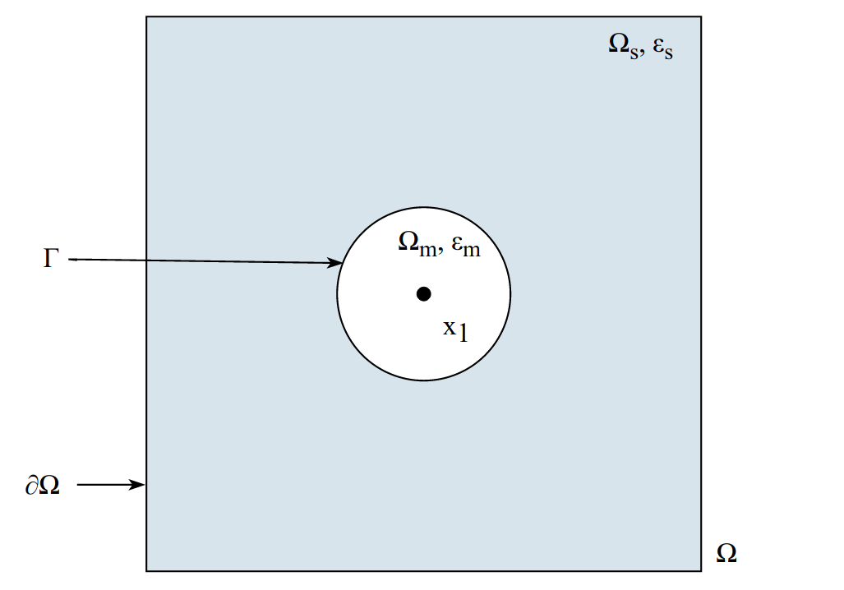
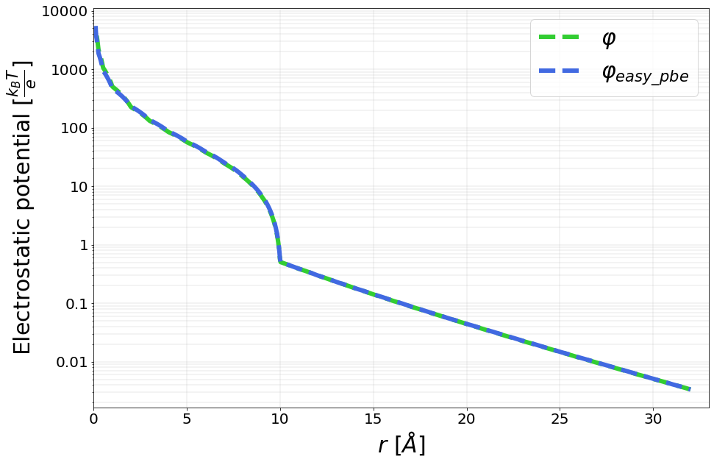
Validation Test Cases

Slide 37
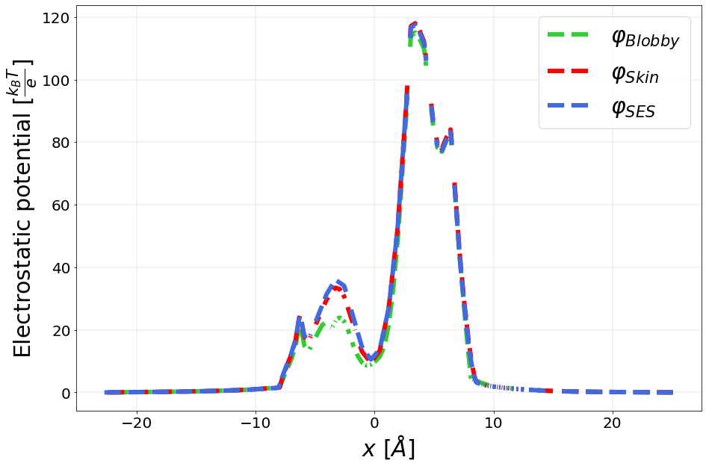
Numerical Results on Real Molecules Crambin test case
Surface type | Ref-Level | Times | Number of mesh cells
Blobby | 2-5-9 | P: 47.3448 s M: 64.404 s R: 154.745 s | 1334572
Skin | 2-5-9 | P: 44.529 s M: 5.750 s R: 62.073 s | 1218722
SES | 2-5-9 | P: 45.913 s M: 5.668 s R: 61.610 s | 1206458

Slide 38
Bibliografy
[1] https://github.com/carlodefalco/easy_pbe.git.
[2] http://p4est.github.io.
[3] http://optimad.github.io/bitpit/modules/index.html#PABLO.
[4] https://www.ssisc.org/lis/lis-ug-en.pdf.
[5] N. Baker, M. Holst, and F. Wang. Adaptive multilevel finite element solution of the poisson-boltzmann equation ii. refinement at solvent-accessible surfaces in biomolecular systems. J. Comput. Chem., 21:1343– 1352.
[6] H.M. Berman, J. Westbrook, Z. Feng, G. Gilliland, T.N. Bhat, H. Weissig, I.N. Shindyalov, and P.E. Bourne. The protein data bank. Nucleic Acids Research, 28:235–242, 2000. http://www.rcsb.org/.
[7] J.F. Blinn. A generalization of algebraic surface drawing. ACM T. Graph., 1(3):235–256, 1982.
[8] A.M. Bonvin, J.A. Rullmann, R.M. Lamerichs, R. Boelens, and R. Kaptein. Direct noe refinement of crambin from 2d nmr data using a slow-cooling annealing protocol, 1993. PDB ID: 1CCM, PDB doi: http://doi.org/10.2210/pdb1CCM/pdb.
[9] A.M. Bonvin, J.A. Rullmann, R.M. Lamerichs, R. Boelens, and R. Kaptein. Ensemble iterative relaxation matrix approach: a new nmr refinement protocol applied to the solution structure of crambin. Proteins, 15:385–400, 1993. doi: http://dx.doi.org/10.1002/prot.340150406.
[10] M. Born. Volumen und hydratationswärme der ionen. Z. Phys., 1(45), 1920.
[11] A. H. Boschitsch and M. O. Fenley. A fast and robust poisson–boltzmann solver based on adaptive cartesian grids. Journal of Chemical Theory and Computation, 7(5):524–1540, 05 2011.
[12] S. Decherchi, José C., C. E. Catalano, M. Spagnuolo, E. Alexov, and W. Rocchia. Between algorithm and model: different molecular surface definitions for the poisson-boltzmann based electrostatic characterization of biomolecules in solution. Commun Comput Phys., 13:61–89, January 2013.
[13] S. Decherchi, C. E. Catalano J. Colmenare and, M. Spagnuolo, E. Alexov, and W. Rocchia. Between algorithm and model: different molecular surface definitions for the poisson-boltzmann based electrostatic characterization of biomolecules in solution. Commun. Comput. Phys., 13:61–89, January 2013. 26
[14] S. Decherchi and W. Rocchia. A general and robust ray-casting-based algorithm for triangulating surfaces at the nanoscale. PLoS One, 8(4):e59744, 2013. http://dx.doi.org/10.1371/journal.pone.0059744.
[15] H. Edelsbrunner. Deformable smooth surface design. Disrete Comput. Geom., 21:87–115, 1999.
[16] E. Jurrus et al. Improvements to the APBS biomolecular solvation software suite. Protein Science, 27:112– 128, 2018.
[17] M. Holst, N. Baker, and F. Wang. Adaptive multilevel finite element solution of the poisson–boltzmann equation i. algorithms and examples. J. Comput. Chem., 21:1319–1342.
[18] B. Honig and A. Nicholls. Classical electrostatics in biology and chemistry. SCIENCE, 268, MAY 1995.
[19] M. Kosloff, A. Travis, and D. Bosch et al. Integrating energy calculations with functional assays to decipher the specificity of g protein–rgs protein interactions. Nat Struct Mol Biol, 18:846—-853, 2011.
[20] A. Kucherova, S. Strango, S. Sukenik, and M. Theillard. Computational modeling of protein conformational changes - application to the opening sars-cov-2 spike. Journal of Computational Physics, 444:110591, 2021.

Slide 39
Bibliografy
[21] A. Lee, W. Geng, and S. Zhao. Regularization methods for the poisson-boltzmann equation: Comparison and accuracy recovery. Journal of Computational Physics, 426:109958, 2021.
[22] B. Lee and F. M. Richards. The interpretation of protein structures: Estimation of static accessibility. J. Mol. Biol., 55:379–400, 1971.
[23] C. Li, Z. Jia, A. Chakravorty, S. Pahari, Y. Peng, S. Basu, M. Koirala, S.K. Panday, M. Petukh, L. Li, and E. Alexov. Delphi suite: New developments and review of functionalities. J Comput Chem., 40(28):2502– 2508, Oct 2019.
[24] L. Li, C. Li, S. Sarkar, J. Zhang, S. Witham, Z. Zhang, L. Wang, N. Smith, M. Petukh, and E. Alexov. Delphi: a comprehensive suite for delphi software and associated resources. BMC Biophys, 4(1), May 2012.
[25] M. Mirzadeh, M. Theillard, and F. Gibou. A second-order discretization of the nonlinear poisson–boltzmann equation over irregular geometries using non-graded adaptive cartesian grids. Journal of Computational Physics, 230(5):2125–2140, 2011.
[26] A. Nicholls and B. Honig. A rapid finite difference algorithm, utilizing successive over-relaxation to solve the poisson-boltzmann equation. J. Comput. Chem., 12:435–445., 1991.
[27] W. Rocchia. Poisson-boltzmann equation boundary conditions for biological applications. Mathematical and Computer Modelling, 41(10):1109–1118, 2005. Modelling Complex Systems in Molecular Biology and Tumor Dynamics and Control.
[28] R. Rohs, S. M. West, A. Sosinsky, P. Liu, R. S. Mann, and B. Honig. The role of dna shape in protein – dna recognition. nature, 461:1248–1253, 2009.
[29] F. B. Sheinerman, R. Norel, and B. Honig. Electrostatic aspects of protein–protein interactions. Current Opinion in Structural Biology, 10(2):153–159, 2000. [30] H.L. Sun and T. Jiang. Crystal structure of nerve growth factor in complex with lysophosphatidylinositol, 2015. PDB ID: 4XPJ, PDB doi: http://doi.org/10.2210/pdb4XPJ/pdb.
[31] H.L. Sun and T. Jiang. The structure of nerve growth factor in complex with lysophosphatidylinositol. Acta Crystallogr F Struct Biol Commun, 71:906–912, 2015. doi: http://dx.doi.org/10.1107/ S2053230X15008870.
[32] E. Alexov W. Rocchia and B. Honig. Extending the applicability of the nonlinear poisson-boltzmann equation: Multiple dielectric constants and multivalent ions. J. Phys. Chem. B, 105(28):6507–6514.
[33] A.C. Walls, Y.J. Park, M.A. Tortorici, A. Wall, Seattle Structural Genomics Center for Infectious Disease (SSGCID), A.T. McGuire, and D. Veesler. Sars-cov-2 spike ectodomain structure (open state), 2020. PDB ID: 6VYB, PDB doi: http://doi.org/10.2210/pd6VYB/pdb.
[34] A.C. Walls, Y.J. Park, M.A. Tortorici, A. Wall, A.T. McGuire, and D. Veesler. The structure of nerve growth factor in complex with lysophosphatidylinositol. Cell, 181:281, 2020. doi: http://dx.doi.org/ 10.1016/j.cell.2020.02.058. 27
[35] J. A. Wilson, A. Bender, T. Kaya, and P. A. Clemons. Alpha shapes applied to molecular shape characterization exhibit novel properties compared to established shape descriptors. J. Chem. Inf. Model., 49(10):2231–2241, 2009.
[36] Y. Zhang, G. Xu, and C. Bajaj. Quality meshing of implicit solvation models of biomolecular structures. Comput. Aided Geom. Des., 23:510–530, 2006.
[37] T. Zhou, T. Tsybovsky, and P.D. Kwong et al. Antibodies with potent and broad neutralizing activity against antigenically diverse and highly transmissible sars-cov-2 variants. Biorxiv, 2021. doi: http: //dx.doi.org/10.1101/2021.02.25.432969.
[38] T. Zhou, T. Tsybovsky, and P.D. Kwong. Cryo-em structure of the spike of sars-cov-2 omicron variant of concern, 2021. PDB ID: 7TB4, PDB doi: http://doi.org/10.2210/pdb7TB4/pdb.

